Slide 1
AJAX with Fetch

Slide 2
AJAX
Why is it useful?
The web is full of data - often, websites "ask" for data from servers which hold different types of data (txt, json, images, databases, etc.)
What we know about JS so far does not give us any way to process data outside of our JS program. That's where AJAX comes in!
How do we use it?
fetch (a built-in JavaScript function)
A touch of Promises to elegantly control success (200) vs. error (non-200) responses from a server

Slide 3
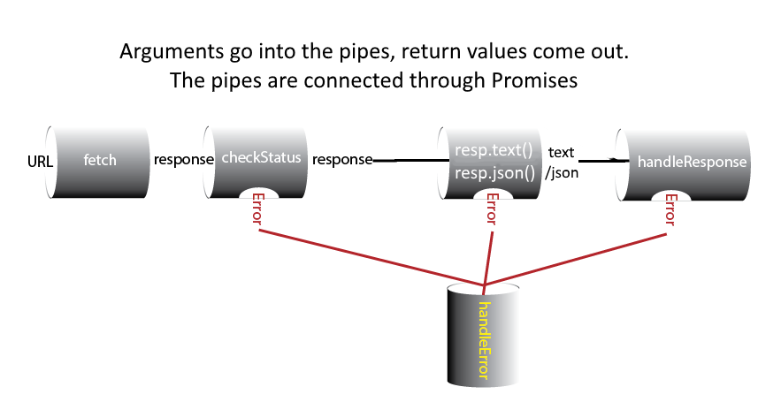
The Promise Pipeline

Slide 4
Mechanics
We initiate a fetch of a URL
A fetch call returns a Promise object
The .then method on a Promise object returns a Promise object
Our first .then(checkStatus) checks the status of the response to makes sure the server responded with an OK. The result of that first .then is another Promise object with the response as the value of the Promise.
We .then(resp => resp.json()) which also returns a Promise object with a JSON object as the value
We .then(processData) which will do something with the response from the server.
If at any time there is an error, the execution falls down to the .catch method on the Promise chain
Chaining of Promises gives us a nice data flow, like down a pipe!

Slide 5
function makeRequest() {
fetch(BASE_URL + "?query=params")
.then(checkStatus)
.then(res => res.json())
//.then(res => res.text())
.then(processData)
.catch(handleError);
}
Making a request and then chaining with .then/.catch
async function makeRequest() {
try {
let res = await fetch(BASE_URL + "?query=params");
await checkStatus(res);
res = await res.json();
//res = await res.text();
processData(res);
} catch(err) {
handleError(err);
}
}
Making a request and then using async/await

Slide 6

Exercise 1: Ajax Pets
Given these starter files, create an AJAX-powered gallery of pet images that allows you to switch between kitty and puppy images without reloading the page. You can view the finished product here.

Slide 7
Exercise 1: Ajax Pets API URL
Service URL: https://courses.cs.washington.edu/courses/cse154/webservices/pets/ajaxpets.php
Query Parameters (required):
?animal=<value>
Details: animal is the name of the query parameter you need to assign a value to. This API recognizes either a value of puppy or kitty.
Example Request (with puppy as the value):

Slide 8
Exercise 1: Ajax Pets API Response Format
Response Format: Plain Text
https://path/to/pet/img0.jpg
https://path/to/pet/img1.jpg
https://path/to/pet/img2.jpg
https://path/to/pet/img3.jpg
...

Slide 9
Exercise 1: Ajax Pets Implementation
The provided starter code includes a module-pattern template we've been using to get you started, named ajaxpets.js. You will need to implement the JavaScript to incorporate AJAX and make a request with the Ajax Pets API URL with the parameter animal of value kitty or puppy, depending on which radio button is selected.
When a request returns a response successfully with the plain text response of image paths, write JS to add img tags as children to the #pictures div for each image path returned on a new line.
Hint: you should listen for the change event to know when to be making the corresponding fetch request

Slide 10
Solution
https://courses.cs.washington.edu/courses/cse154/19sp/sections/week05-tues/code/solution/ajaxpets/ajaxpets.js

